Slide 1



UNIVERSITY INSTITUTE OF ENGINEERING
COMPUTER SCIENCE ENGINEERING
Bachelor of Engineering
Cloud Computing(CST-411)
Prepared By: Ms. Himanshu(E11818)
Topic: Service Oriented Architecture
DISCOVER . LEARN . EMPOWER

Slide 2
Learning Objectives & Outcomes
Objective:
To understand the Service Oriented Architecture(SOA)
Outcome:
Student will understand
SOA
Principles of SOA
Components of SOA

Slide 3
Overview
What is SOA?
What is Service?
Components of SOA
Principles of SOA
SOA Architecture
Advantages of SOA
Disadvantages of SOA

Slide 4
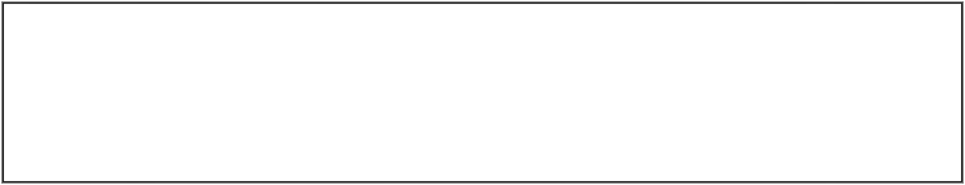
Service Oriented Architecture (SOA)

Slide 5
Service Oriented Architecture (SOA)
An architecture based on reusable, well-defined services implemented by IT components.
Components are loosely coupled.
Provides platform, technology and language independence

Slide 6
What is a Service?
A service is a package of closely related standardized functions, which are called repeatedly in a similar fashion, and should therefore be implemented by a dedicated facility, which can be specialized to perform them.
A service can be partitioned and have multiple service functions.
The smallest subunits within service functions are called
service primitives.
Windows service : RPC Locator, Event Log
Software Service: Distribution, Alert, Log

Slide 7
Service Connections
Service consumer sends a service request to the service provider, and the service provider sends the service response to the service consumer.
The service connection is understandable to both the service consumer and service provider.
There are two major roles within Service-oriented Architecture:
Service provider: The service provider is the maintainer of the service and the organization that makes available one or more services for others to use.

Slide 8
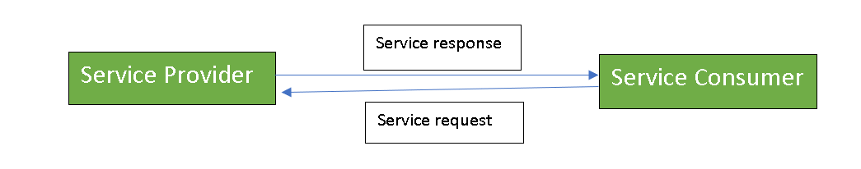
Service consumer: The service consumer can locate the service metadata in the registry and develop the required client components to bind and use the service.

Slide 9
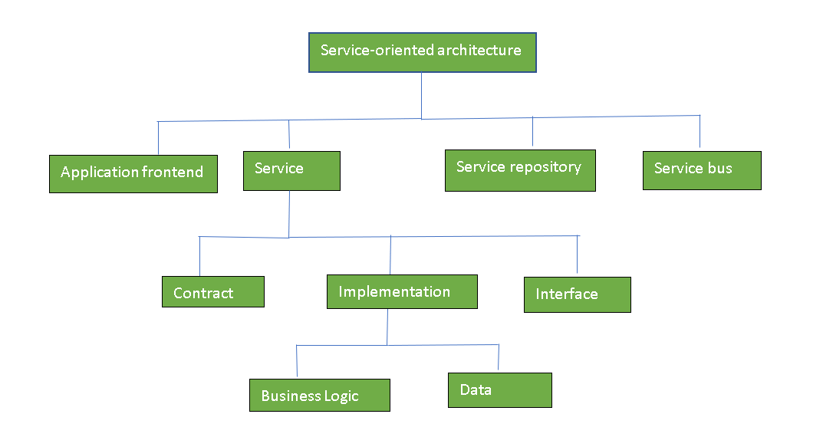
Components of SOA

Slide 10

SOA Architectural
Characteristics/Principles
Standardized Service Contracts
Loose Coupling
Abstraction
Reusability
Autonomy
Statelessness
Discoverability
Composability

Slide 11

Standardized Service Contracts
Services adhere to a service-description.
Services use service contract to
Express their purpose
Express their capabilities
Use formal, standardized service contracts

Slide 12
Loose Coupling
Services minimize dependencies on each other.
Create specific types of relationships within and outside of service boundaries with a constant emphasis on reducing (“loosening”) dependencies dependencies between
Service contract
Service implementation
Service consumers

Slide 13
Abstraction
Services hide the logic they encapsulate from the outside world.
Avoid the proliferation of unnecessary service information, meta-data.
Hide as much of the underlying details of a service as possible.
Enables and preserves the loosely coupled relationships.
Plays a significant role in the positioning and design of service compositions compositions.

Slide 14
Service Reusability
Logic is divided into services with the intent of maximizing reuse.
Designed as components, services can be reused more effectively, thus reducing development time and the associated costs.

Slide 15

Autonomy
Services should have control over the logic they encapsulate
Represents the ability of a service to carry out its logic independently of outside influences
To achieve this, services must be more isolated
Primary benefits
Increased reliability
Behavioral predictability

Slide 16
Statelessness
Ideally, services should be stateless.
Incorporate state management deferral extensions within a service service design goals
Increase service scalability
Support design of agnostic logic and improve service reuse

Slide 17
Discoverability
Services can be discovered (usually in a service registry).
Service contracts contain appropriate meta data for discovery which which also communicates purpose and capabilities to humans.
Store meta data in a service registry or profile documents

Slide 18
Composability
Services break big problems into little problems. Related to Reusability principle
Service execution should efficient in that individual processing should be highly tuned
Flexible service contracts to allow different types of data exchange exchange requirements for similar functions

Slide 19
Interoperability
Services should use standards that allow diverse subscribers subscribers to use the service.
This is considered so obvious these days that it is often dropped as a principle.

Slide 20
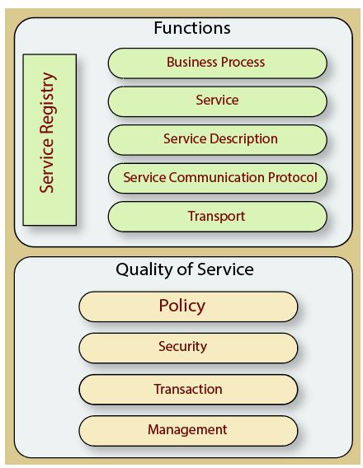
SOA Architecture

Slide 21
Advantages of SOA
SOA has the following advantages:
Easy to integrate
Manage Complexity
Platform Independence
Loose coupling
Parallel Development
Available
Reliable

Slide 22
Disadvantages of SOA
High overhead
High investment
Complex service management

Slide 23
References
Text books:
Buyya, Rajkumar, James Broberg, and Andrzej M. Goscinski, eds. Cloud computing: Principles and paradigms. Vol. 87. John Wiley & Sons, 2010.
Miller, Michael. Cloud computing: Web-based applications that change the way you work and collaborate online. Que publishing, 2008
Websites:
https://www.javatpoint.com/service-oriented-architecture
https://www.geeksforgeeks.org/service-oriented-architecture/

Slide 24
THANK YOU

